Slide 1

JavaScript Advanced
Course Introduction
SoftUni Team
Technical Trainers
Software University
https://softuni.bg

Slide 2
Table of Contents
Introduction
Course Objectives
Trainers and Team
Course Details

Slide 3
Have a Question?
sli.do
#js-advanced

Slide 4











SoftUni Diamond Partners

Slide 5



Educational Partners

Slide 6

JS Advanced
Course Objectives

Slide 7
Course Objectives
Extends the JS Fundamentals course
Advanced coding skills for the JS language
Use contemporary techniques and paradigms
Master the DOM API and user interaction
Write code to solve realistic practical problems

Slide 8
JS Advanced – Course Topics
Syntax, Functions and Statements
Arrays & Matrices
Objects & Composition
DOM Introduction
DOM Events and Manipulation

Slide 9
JS Advanced – Course Topics
Advanced Functions
Unit Testing
Classes
Prototypes and Inheritance
Workshop

Slide 10

Trainers and Team

Slide 11
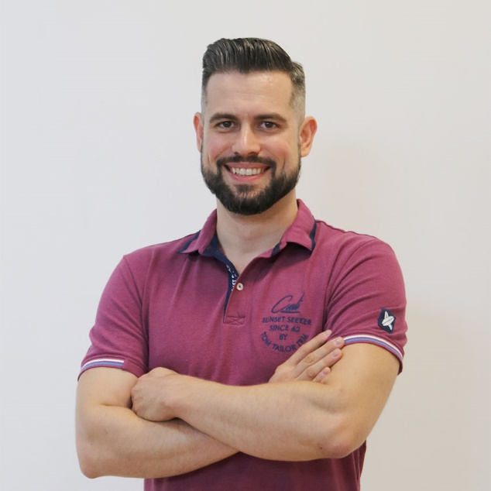
Ivaylo Papazov
Senior Full Stack and Team Lead @ Motion Software
Technical Trainer @ SoftUni
Experience in JS, C#, Node.js, React, ASP.NET MVC
TelerikAcademy Graduate

Slide 12
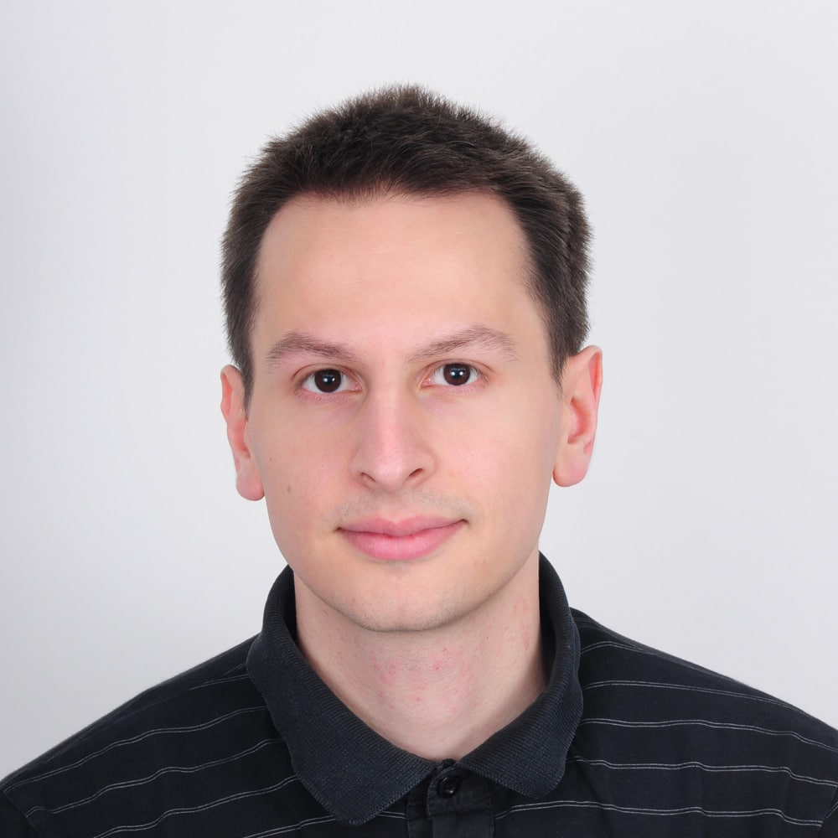
Viktor Kazakov
Worked on scalable high traffic distributed systems
Experience in JS, TS, Node.js, Angular, C#, ASP.NET MVC, Azure Cloud
Former Trainer @ Software University
Former Full-stack Developer @Software University
Former Full-stack Developer @Developsoft

Slide 13

Course Details
Schedule

Slide 14

Practical Exam
Structure: 3 problems for 4 hours
Exam: 27 Jun 2021
Retake: 12 Aug 2021
Problems description:
Classes
DOM
Unit Testing
Link to Exams

Slide 15
Theoretical Exam
20 questions for 30 minutes
Multiple-choice
English
Automated quiz system
Available online
You can submit your answers just one time

Slide 16
JS Advanced Module Timeline
JS Advanced
Start: 20. May 2021
Exam: 27. Jun 2021
20.
27.
6 weeks
4 times per week
May
Jun
JS Applications
Start: 29. Jun 2021
Exam: 8. Aug 2021
29.
8.
6 weeks
4 times per week
Jun
Jul
Aug
Exam Retakes
JS Advanced: 12. Aug 2021
JS Applications: 16. Aug 2021
August

Slide 17
Course Scoring
Practice grade:
Theory grade:
SoftUni Certificate: 5.00 from Practice
CPE Certificate: 3.00 average from Practice + Theory
Practical Exam
Homework
100 %
+5 %
Theoretical Exam
100 %
17

Slide 18




Course Web Site, Forum and FB Group
Official web site:
Official discussion forum:
Official Facebook group:
Official SoftUni JavaScript Community:
softuni.bg/trainings/3217/js-advanced-may-2021
softuni.bg/forum/categories/19/
facebook.com/groups/JSAdvancedMay2021
facebook.com/groups/SoftUniJavaScriptCommunity/

Slide 19
Questions?
Notes:
19

Slide 20
Trainings @ Software University (SoftUni)
Software University – High-Quality Education, Profession and Job for Software Developers
softuni.bg, softuni.org
Software University Foundation
softuni.foundation
Software University @ Facebook
facebook.com/SoftwareUniversity
Software University Forums
forum.softuni.bg
Notes:
20

Slide 21

License
This course (slides, examples, demos, exercises, homework, documents, videos and other assets) is copyrighted content
Unauthorized copy, reproduction or use is illegal
© SoftUni – https://about.softuni.bg/
© Software University – https://softuni.bg
Notes:
21

